Slide 1

Predicting Overall Survival for Patients with Metastatic Castration-Resistant Prostate Cancer
Belal Elsiesy, Guanghua Xiao, Ph.D.
Department of Population and Data Sciences,
UT Southwestern Medical Center, Dallas, Texas

Slide 2
Introduction – Prostate Cancer
Prostate cancer (PCa) – 2nd most common cancer among men ^{[2]}
  14.1% of new cancer cases
  6.8% of mortalities
Castration resistant prostate cancer (CPRC) – advanced stage of PCa ^{[3]}
  Resistant to standard treatments such as androgen-deprivation therapy
Prognostic factors for CPRC:
  Eastern Cooperative Oncology Group(ECOG) patient performance status
  bone pain
  prostate-specific antigen(PSA) levels
  Testosterone levels
  alkaline phosphatase(ALP) levels

Slide 3
Introduction - Predictive Model
2014 model ^{[4]} : confirmed known predictive factors and added:
  Disease site
  Lactate dehydrogenase (LDH)
  Opioid analgesic use
  Albumin (ALB)
  Hemoglobin(HB)
My model
  Goal 1: identify prognostic factors in data (new and known)
  Goal 2: accurately predict patient risk

Slide 4
Materials and Methods
Univariate Analysis for Binary Variables:
  Contingency tables
  Chi-squared test
  Fisher’s exact test
  Filter by p < ~0.05/101 (Bonferroni Correction)
Univariate Analysis for Continuous Variables:
  Box plots
  T-tests
  Filter by p < ~0.05/101 (Bonferroni Correction)
Data Source:
  phase 3 clinical trial data
  101 features
  released to the public by Project Data Sphere
Calculating Risk:
  Low Risk: survived >2years
  High Risk: died in <1year
  Other patients: dropped from dataset

Slide 5
Materials and Methods
10-fold cross validation on training set
Machine Learning Predictive Models:
  Support Vector Machine
  Logistic Regression
  Random Forest
  Artificial Neural Network
Survival Analysis:
  Choose best model
  Predict risk group for independent testing set
  Kaplan Meier curves
  Log-rank test
  Variable importance plot

Slide 6
Results

Slide 7
Dataset General Information
Variable | Training Set | Testing Set
# of Patients | 470 | 476
Mean Survival Time | 648 | 372.5
Age
18-64 | 159 | 111
65-74 | 212 | 211
75+ | 99 | 154
ECOG Status
Fully Active | 223 | 220
Restricted Activity | 247 | 256
Status
Alive | 158 | 338
Dead | 312 | 138

Slide 8
Dataset General Information
Variable | Training Set | Testing Set
# of Patients | 470 | 476
Mean Survival Time | 648 | 372.5
Age
18-64 | 159 | 111
65-74 | 212 | 211
75+ | 99 | 154
ECOG Status
Fully Active | 223 | 220
Restricted Activity | 247 | 256
Status
Alive | 158 | 338
Dead | 312 | 138

Slide 9
Dataset General Information
Variable | Training Set | Testing Set
# of Patients | 470 | 476
Mean Survival Time | 648 | 372.5
Age
18-64 | 159 | 111
65-74 | 212 | 211
75+ | 99 | 154
ECOG Status
Fully Active | 223 | 220
Restricted Activity | 247 | 256
Status
Alive | 158 | 338
Dead | 312 | 138

Slide 10
Dataset General Information
Variable | Training Set | Testing Set
# of Patients | 470 | 476
Mean Survival Time | 648 | 372.5
Age
18-64 | 159 | 111
65-74 | 212 | 211
75+ | 99 | 154
ECOG Status
Fully Active | 223 | 220
Restricted Activity | 247 | 256
Status
Alive | 158 | 338
Dead | 312 | 138

Slide 11
Dataset General Information
Variable | Training Set | Testing Set
# of Patients | 470 | 476
Mean Survival Time | 648 | 372.5
Age
18-64 | 159 | 111
65-74 | 212 | 211
75+ | 99 | 154
ECOG Status
Fully Active | 223 | 220
Restricted Activity | 247 | 256
Status
Alive | 158 | 338
Dead | 312 | 138

Slide 12
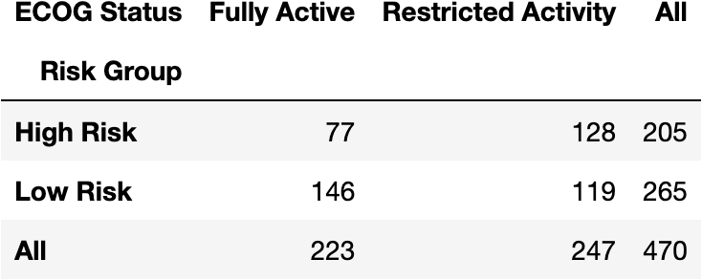
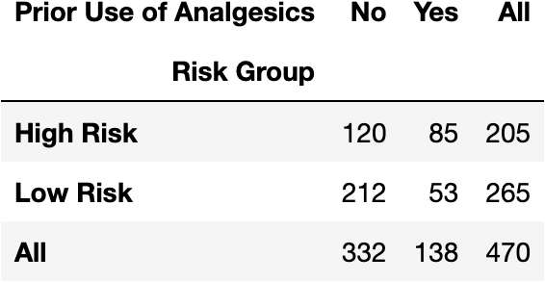
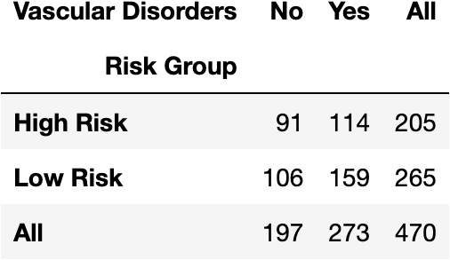
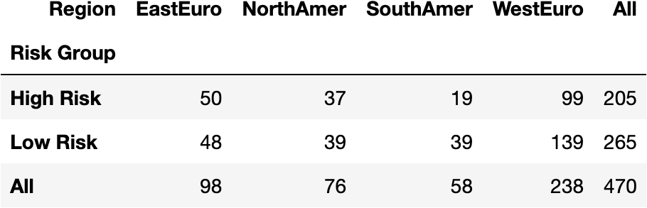
Binary /
Categorical variables
(p < 0.0005)

Slide 13
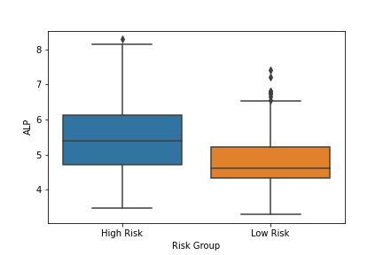
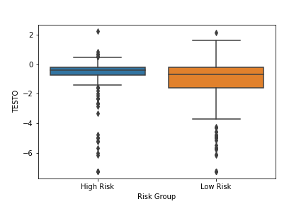
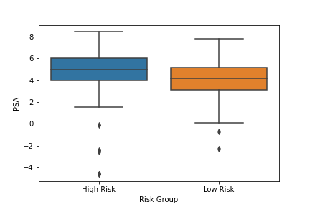
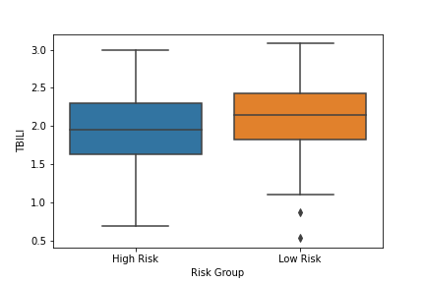
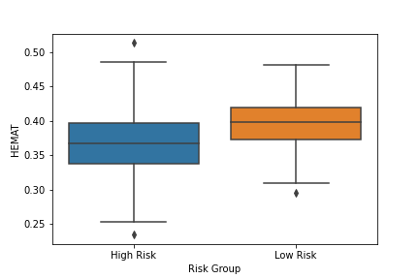
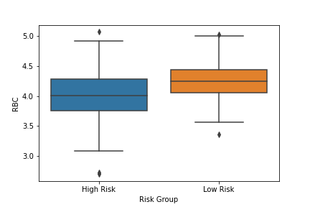
Continuous variables (p < 0.0005)
Alkaline
Phosphatase
Prostate Specific Antigen
Testosterone
Total Bilirubin
Red Blood Cells
Hematocrit

Slide 14
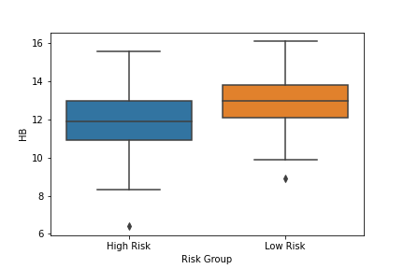
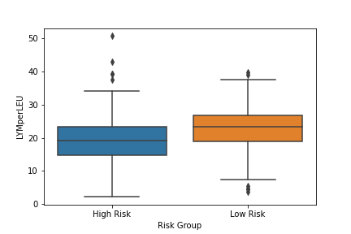
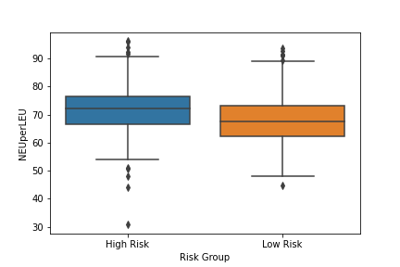
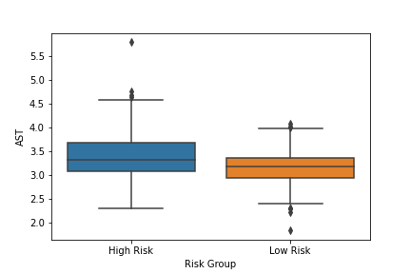
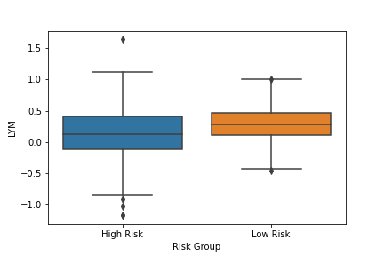
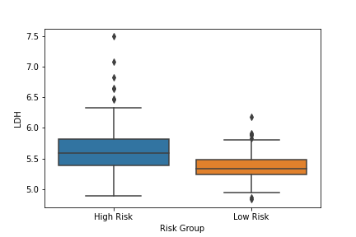
Continuous variables (p < 0.0005)
Lymphocyte to leucocyte ratio
Neutrophil to leucocyte ratio
Hemoglobin
Aspartate Aminotransferase
Lactate
Dehydrogenase
Lymphocytes

Slide 15
Model Prediction Accuracy
Model | Prediction Accuracy (std)
Support Vector Machine (Default Parameters) | 63.36% (0.94%)
Support Vector Machine (Best Parameters: 'C': 10, 'gamma': 0.0001) | 71.31% (3.51%)
Logistic Regression | 79.66% (5.41%)
Random Forest (n estimators = 100) | 81.05% (7.44%)
Random Forest (n estimators = 300) | 81.45% (5.64%)
Artificial Neural Network (epochs=100) | 67.02% (9.19%)
Artificial Neural Network (epochs=350) | 69.15% (6.68%)
Artificial Neural Network (epochs=350, scaled data) | 72.55% (4.09%)
Artificial Neural Network (epochs = 350, scaled data, less complex model) | 72.13% (4.70%)

Slide 16
Model Prediction Accuracy
Model | Prediction Accuracy (std)
Support Vector Machine (Default Parameters) | 63.36% (0.94%)
Support Vector Machine (Best Parameters: 'C': 10, 'gamma': 0.0001) | 71.31% (3.51%)
Logistic Regression | 79.66% (5.41%)
Random Forest (n estimators = 100) | 81.05% (7.44%)
Random Forest (n estimators = 300) | 81.45% (5.64%)
Artificial Neural Network (epochs=100) | 67.02% (9.19%)
Artificial Neural Network (epochs=350) | 69.15% (6.68%)
Artificial Neural Network (epochs=350, scaled data) | 72.55% (4.09%)
Artificial Neural Network (epochs = 350, scaled data, less complex model) | 72.13% (4.70%)

Slide 17
Model Prediction Accuracy
Model | Prediction Accuracy (std)
Support Vector Machine (Default Parameters) | 63.36% (0.94%)
Support Vector Machine (Best Parameters: 'C': 10, 'gamma': 0.0001) | 71.31% (3.51%)
Logistic Regression | 79.66% (5.41%)
Random Forest (n estimators = 100) | 81.05% (7.44%)
Random Forest (n estimators = 300) | 81.45% (5.64%)
Artificial Neural Network (epochs=100) | 67.02% (9.19%)
Artificial Neural Network (epochs=350) | 69.15% (6.68%)
Artificial Neural Network (epochs=350, scaled data) | 72.55% (4.09%)
Artificial Neural Network (epochs = 350, scaled data, less complex model) | 72.13% (4.70%)

Slide 18
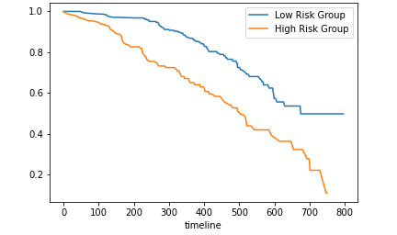
Survival Analysis for Predicted Risk Groups from Random Forest Model (Independent Testing Set)
Pv = 1.6E-7
(Log rank test)

Slide 19
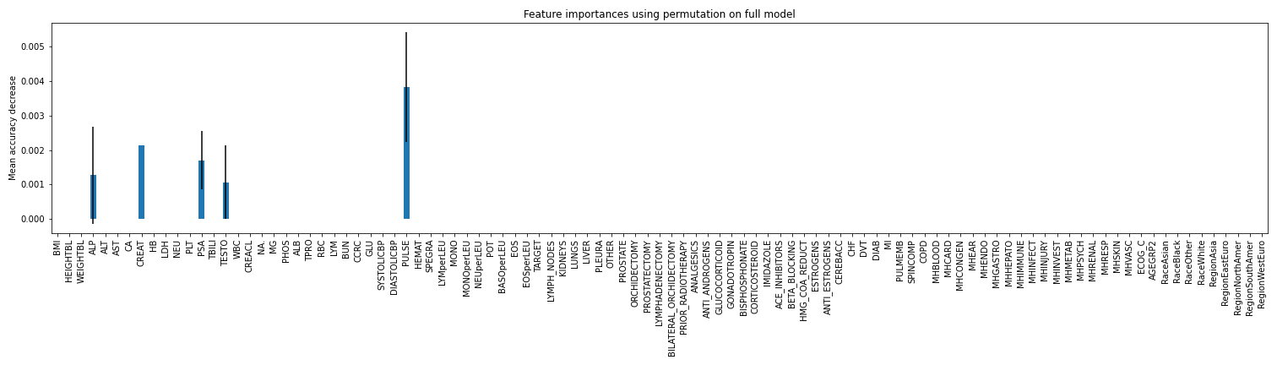
Random Forest Model Feature Importance

Slide 20
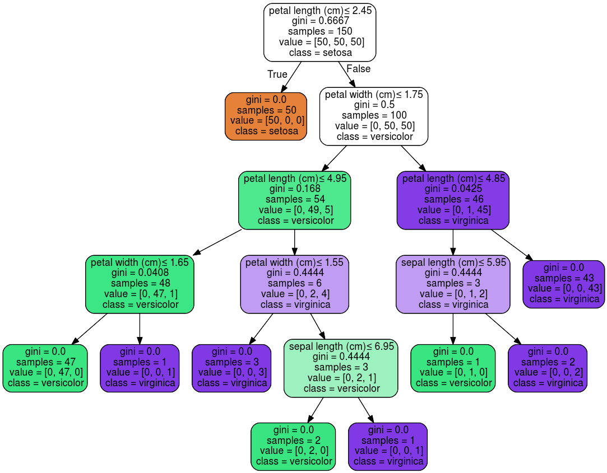
Random Forests
Decision tree
Classification
Split on nodes based on:
  Entropy - uncertainty
  Information Gain
Random Forest
Group of decision trees
  Sample data
  Different weights for different splits
Classify based on most ‘votes’
[5]
Notes:
Ex: If 80% of patients with ECOG status 1 (Restricted Activity) are high risk, we are 20% uncertain
Ex: If 50% of patients with diabetes are high risk, we are 50% uncertain and gain little information from that split

Slide 21

Conclusions
Goal 1: identify prognostic factors in data
Prognostic Factors(p < 0.0005; based on Bonferroni correction)
  Confirm previously known variables:
    Regular Testing + 2014 Model
  New Predictors (Confirmed by other analysis of same dataset^{)[1]}:
    Immune/Lymphatic system, Kidney function, Vascular system and hematology
Goal 2: Accurately predict patient risk
Model Prediction Performance
  Random Forest Classifier performed best
  Traditional Models outperformed Artificial Neural Network
Notes:
Ensemble model → Prevent overfitting to data, unlike others
Clear predictive features (PSA, TESTO, ALP) + CREAT → trees split on them (high information gain)
ANNs work well will large amounts of data, not small amounts

Slide 22
Future Directions
Utilize new understanding of risk factors for diagnosis and prognosis
Incorporate genomics data and pathology imaging into model given current research advances
Develop similar prognostic models for other types of cancer

Slide 23
Acknowledgements
STARS Staff
  Dr. Joel Goodman
  Lynn Tam
  Maria Sandlin
  Mary Leyendecker
  Pearlie Crawford
  Kristie Conner
Dr. Guanghua Xiao
Dr. Yang Xie

Slide 24
Literature Cited
Guinney, J., Wang, T., et al,Prostate Cancer Challenge DREAM Community (2017). Prediction of overall survival for patients with metastatic castration-resistant prostate cancer: development of a prognostic model through a crowdsourced challenge with open clinical trial data. The Lancet. Oncology, 18(1), 132–142. https://doi.org/10.1016/S1470-2045(16)30560-5
Sung, H, Ferlay, J, Siegel, RL, Laversanne, M, Soerjomataram, I, Jemal, A, Bray, F. Global cancer statistics 2020: GLOBOCAN estimates of incidence and mortality worldwide for 36 cancers in 185 countries. CA Cancer J Clin. 2021: 71: 209- 249. https://doi.org/10.3322/caac.21660
Hotte, S. J., & Saad, F. (2010). Current management of castrate-resistant prostate cancer. Current oncology (Toronto, Ont.), 17 Suppl 2(Suppl 2), S72–S79. https://doi.org/10.3747/co.v17i0.718
Halabi, S., Lin, C. Y., Kelly, W. K., Fizazi, K. S., Moul, J. W., Kaplan, E. B., Morris, M. J., & Small, E. J. (2014). Updated prognostic model for predicting overall survival in first-line chemotherapy for patients with metastatic castration-resistant prostate cancer. Journal of clinical oncology : official journal of the American Society of Clinical Oncology, 32(7), 671–677. https://doi.org/10.1200/JCO.2013.52.3696
scikit-learn developers. (2020). Iris. scikit-learn. https://scikit-learn.org/stable/_images/iris.png. s

